Slide 1
Guglielmo Marconi
An Engineer who communicated with the World
Collated and written by Phil Brown M5BTB

Slide 2
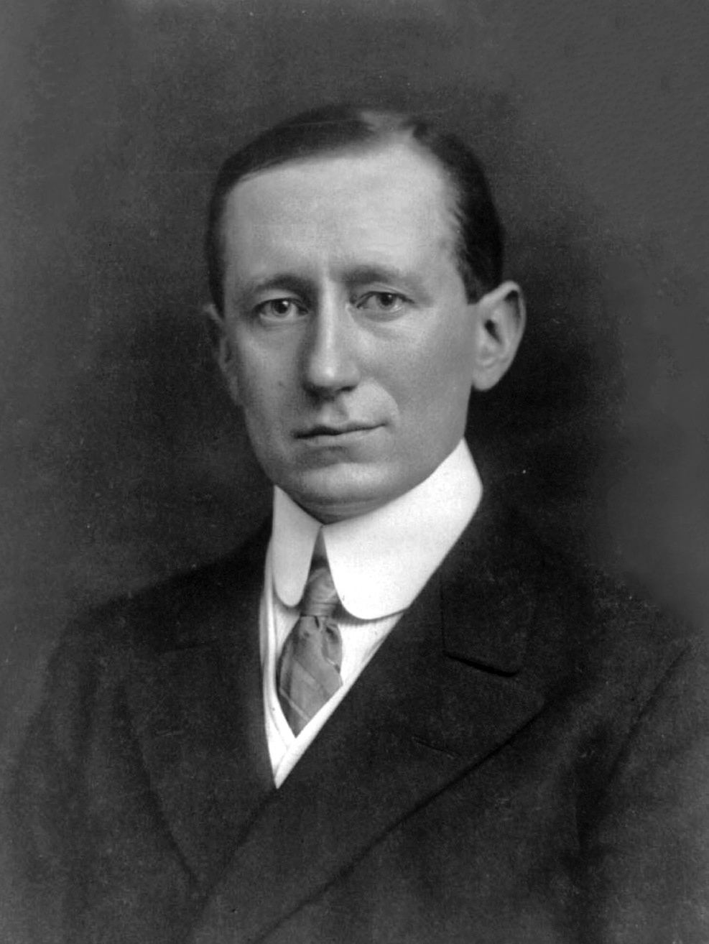
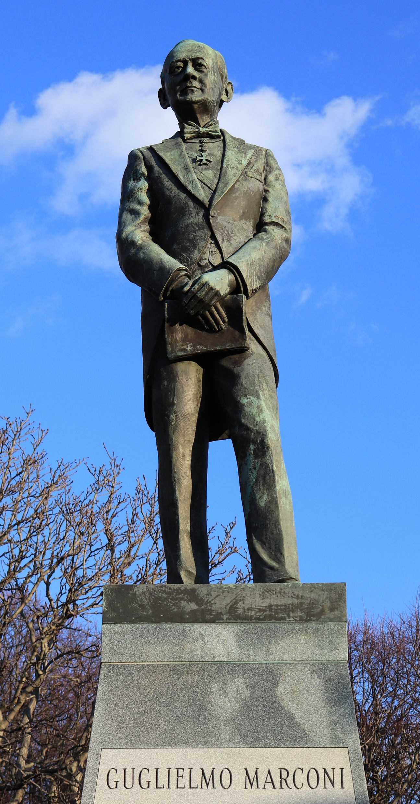
Marconi
Bronze statue of Guglielmo Marconi, sculpted by Saleppichi Giancarlo erected 1975
Marconi 1908

Slide 3
Guglielmo Giovanni Maria Marconi An Introduction
Guglielmo Giovanni Maria Marconi, 1st Marquis of Marconi FRSA (25 April 1874 – 20 July 1937), was an inventor and electrical engineer, known for his pioneering work on long-distance radio transmission, development of Marconi's law, and radio telegraph systems
He is credited as the inventor of radio, and he shared the 1909 Nobel Prize in Physics with Karl Ferdinand Braun "in recognition of their contributions to the development of wireless telegraphy"
Marconi was also an entrepreneur, businessman, and founded The Wireless Telegraph & Signal Company in the United Kingdom in 1897 (which became the Marconi Company), based in Chelmsford
He succeeded in making an engineering and commercial success of radio by innovating and building on the work of previous experimenters and physicists, and in 1929, he was ennobled as a Marchese (marquis) by King Victor Emmanuel III of Italy, and, in 1931 he set up Vatican Radio for Pope Pius XI
Notes:
The amateur radio licence has a clause which stipulates that the licensee shall ensure that the radio equipment is only used for the purpose of self-training in radio communications, including conducting technical investigations, amongst other requirements.

Slide 4
The Young Marconi
Marconi was born into the Italian nobility in Bologna as the second son of Giuseppe Marconi (an Italian aristocratic landowner from Porretta Terme)
His Irish mother Annie Jameson was the daughter of Andrew Jameson of Daphne Castle in County Wexford, Ireland and granddaughter of John Jameson, founder of whiskey distillers Jameson & Sons
He did not attend school or achieve any formal higher education as his parents hired a number of private tutors, and was taught the basics of physical phenomena as well as new theories of electricity, and occasionally attended Bologna University lectures
From his youth, Marconi was interested in science and electricity; in the early 1890s he began working on the idea of "wireless telegraphy"—i.e., the transmission of telegraph messages without connecting wires as used by the electric telegraph
Notes:
Transmission line cabling systems were well understood for the use of telegraphy, but was ‘wire’less next ?

Slide 5
The Young Marconi
Wireless telegraphy was not a new idea; numerous investigators and inventors had been exploring wireless telegraph technologies and even building systems using electromagnetic induction and optical (light) signalling for over 50 years, but none had proven technically and commercially successful
A relatively new development came from Heinrich Hertz, who, in 1888, demonstrated that one could produce and detect electromagnetic radiation, which became known as "Hertzian" waves, and is generally referred to as radio waves now measured in frequency cycles per second, or Hertz
There was a great deal of interest in radio waves in the physics community, but this interest was in the scientific phenomenon, not in its potential as a communication method; generally radio waves were looked upon as an invisible form of light that could only travel along a line of sight path, limiting its range to the visual horizon like existing forms of visual signalling

Slide 6
The Young Marconi
Hertz's death in 1894 brought out published reviews of his earlier discoveries including a demonstration on the transmission and detection of radio waves by the British physicist Oliver Lodge and an article about Hertz's work by Augusto Righi
Righi's article renewed Marconi's interest in developing a wireless telegraphy system based on radio waves, a line of inquiry that Marconi noted other inventors did not seem to be pursuing
Marconi was developing the vision of enabling long distance communication by merging the academic inventions of others into something that could be useful
Notes:
We know what Hertz means in radio technology, but no-one has yet defined what a Marconi is.

Slide 7
Early Development of Radio Telegraphy
At the age of 20, Marconi began to conduct experiments in radio waves, building much of his own equipment in the attic of his home at the Villa Griffone in Pontecchio, Italy with the help of his butler Mignani
He built a Hertz experimental demonstrator and, at the suggestion of Righi, began using a coherer, an early detector based on the 1890 findings of French physicist Édouard Branly
He also used re-established Lodge's experiments, where a coherer changed resistance when exposed to radio waves and in the summer of 1894, he built a storm alarm made up of a battery, a coherer, and an electric bell, which went off when it picked up the radio waves generated by lightning
The coherer had to be re-set every time it was activated by a radio wave pulse
Notes:
Early radio experiments were made using a telegraph morse key as any form of voice communications was still in its infancy.

Slide 8
Early Development of Radio Telegraphy
Late one night, in December 1894, Marconi demonstrated a radio transmitter and receiver that made a bell ring on the other side of room by pushing a telegraph key button, he continued to read through the literature and picked up on the ideas of physicists who were experimenting with radio waves and developed devices, such as portable transmitters and receiver systems
He thought that this type of communications equipment could work over longer distances, turning what was essentially a laboratory experiment into a useful, and commercial, communications system
Marconi came up with a functional system with many components:
A relatively simple oscillator or spark-producing radio transmitter
A wire or metal sheet area suspended at a height above the ground
A coherer receiver, which was a modification of Édouard Branly's original device with refinements to increase sensitivity and reliability
A telegraph key to operate the transmitter to send short and long pulses, corresponding to the dots-and-dashes of Morse code
A telegraph register activated by the coherer which recorded the received Morse code dots and dashes onto a roll of paper tape
In the summer of 1895, Marconi moved his experiments outdoors on his father's estate in Bologna and tried different arrangements and shapes of antenna but even with these improvements he was able to transmit signals only up to one half mile, a distance Oliver Lodge had predicted in 1894 as the maximum transmission distance for radio waves
Notes:
After Branly’s experiments, the Eiffel Tower was used to investigate the effect of different transmitter and receiver technologies on transmission range. This was approved by Gustav Eiffel who wanted to publicise the practical use of his tower. The tower was scheduled to be demolished 10 years after its construction.

Slide 9
Transmission Breakthrough ! Finding Funding ?
A breakthrough came in the summer of 1895, when Marconi found that much greater range could be achieved after he raised the height of his antenna and, borrowing from a technique used in wired telegraphy, grounding his transmitter and receiver
The Marconi system was now capable of transmitting signals up to 2 miles (3.2 km) and over hills, his monopole antenna transmission range compared to the dipole antennas used by Hertz, and radiated vertically polarized radio waves which could travel longer distances
Marconi concluded that a device could become capable of spanning greater distances with additional funding and research, which could prove valuable both commercially and militarily and viewed his experimental apparatus to be the first engineering-complete, commercially successful radio transmission system
Marconi wrote to the Italian Ministry of Post and Telegraphs describing his wireless telegraph machine and asking for funding, but never received a response as his suggestions were dismissed by the ministry which referred "to the Lungara" in internal documentation, referring to the insane asylum on Via della Lungara in Rome
Notes:
The Italian authorities thought he was insane.

Slide 10
Transmission Breakthrough ! Finding Funding ?
Marconi was encouraged not to reveal his transmission results until after a patent was obtained, and was encouraged to come to England where he believed it would be easier to find the necessary funds to convert his experiments into practical use
He visited London in early 1896 at the age of 21, accompanied by his Irish mother, to seek support for his work; though he spoke fluent English in addition to Italian
His various pieces of apparatus interested both the Admiralty and the Chief Electrical Engineer of the British Post Office, leading him to apply to patent his system on 2 June 1896, entitled British Patent number 12039 titled "Improvements in Transmitting Electrical impulses and Signals, and in Apparatus therefor", which would become the first patent for a radio wave base communication system

Slide 11
Interest of British Government
Marconi made the first demonstration of his system for the British government in July 1896
A further series of demonstrations for the British followed, and, by March 1897, Marconi had transmitted Morse code signals over a distance of about 6 kilometres (3.7 mi) across Salisbury Plain
On 13 May 1897, Marconi sent the first ever wireless communication over open sea – a message was transmitted over the Bristol Channel from Flat Holm Island to Lavernock Point in Penarth, a distance of 6 kilometres (3.7 mi), the message read "Are you ready"
The transmitting equipment was almost immediately relocated to Brean Down Fort on the Somerset coast, stretching the range to 16 kilometres (9.9 mi).

Slide 12
Spark Gap Transmitter
A spark-gap transmitter generates radio waves by means of an electric spark, and were the first type of radio transmitter, and were the main type used during the wireless telegraphy or "spark" era, the first three decades of radio, from 1887 to the end of World War I
German physicist Heinrich Hertz built the first experimental spark-gap transmitters in 1887, with which he proved the existence of radio waves and studied their properties
A fundamental limitation of spark-gap transmitters is that they generate a series of brief transient pulses of radio waves called damped waves that were broadband in frequency
The radio waves produced are unable to generate the continuous waves used to carry audio (sound) in modern AM or FM radio transmission
Transmitted information was by radiotelegraphy; the operator switched the transmitter on and off with a telegraph key, creating pulses of radio waves to spell out text messages in Morse code
Notes:
Radio frequency tuning, as we know it, did not exist

Slide 13
Spark Gap Transmitter
The first practical spark gap transmitters and receivers for radiotelegraphy communication were developed by Guglielmo Marconi around 1896
The initial spark gap transmitters were not tuned and this reduced their effectiveness; around 1899 to 1900, applying an idea developed by Oliver Lodge, Marconi added tuning to his transmitters (and receivers) which improved their effectiveness, this was referred to as ‘Syntony’
When using tuned circuits, Marconi referred to the antenna coupling / tuning assembly as a ‘jigger.’
In 1911, the Marconi company purchased the rights to the Lodge Syntony patent
Notes:
Yes, there was a patent to cover tuning an antenna

Slide 14
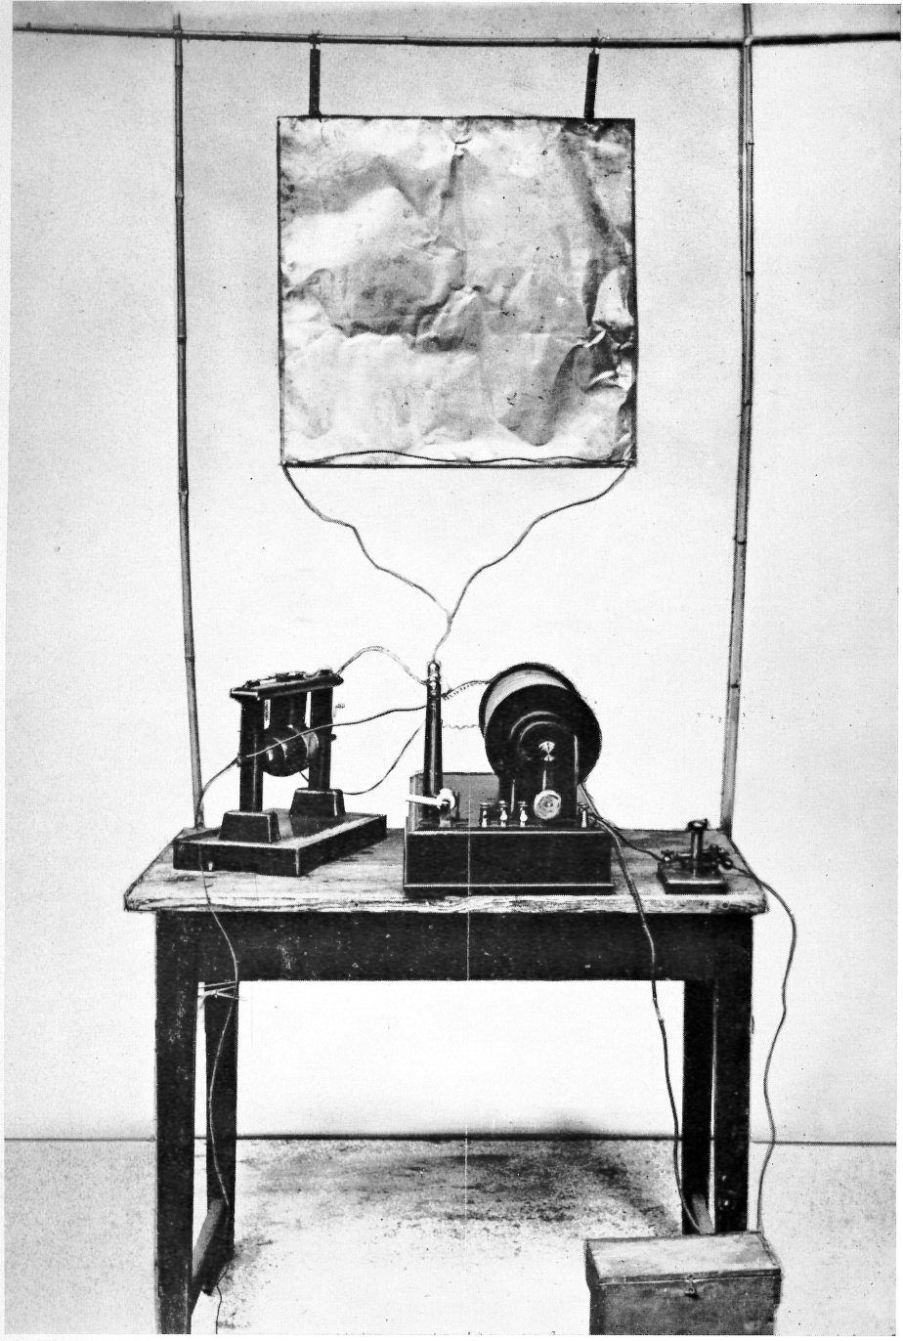
The First Transmitter of Marconi
Notes:
Marconi's first transmitter incorporating a monopole antenna. It consisted of an elevated copper sheet (top) connected to a Righi spark gap (left) powered by an induction coil (center) with a telegraph key (right) to switch it on and off to spell out text messages in Morse code.

Slide 15
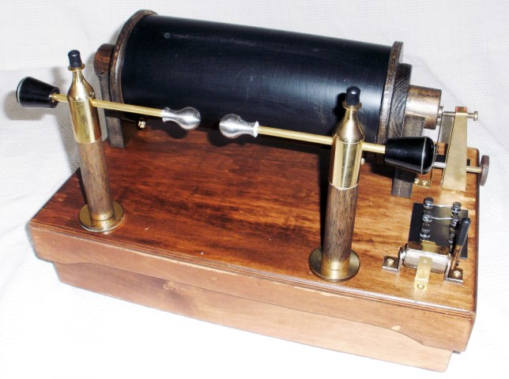
Spark Gap Induction Coil
Notes:
From 1902.
A similar method is used to activate vehicle spark plugs

Slide 16
The Coherer
The coherer was a primitive form of radio signal detector used in the first radio receivers during the wireless telegraphy era at the beginning of the 20th century
Its use in radio was based on the 1890 findings of French physicist Édouard Branly and adapted by other physicists and inventors over the next ten years and consists of a tube or capsule containing two electrodes spaced a small distance apart with loose metal filings in the space between
When a radio frequency signal is applied to the device, the metal particles would cling together or "cohere", reducing the initial high resistance of the device, thereby allowing a much greater direct current to flow through it activating a bell, or a Morse paper tape recorder to make a record of the received signal
The metal filings in the coherer remained conductive after the signal (pulse) ended so that the coherer had to be "decohered" by tapping it with a clapper actuated by an electromagnet, each time a sgnal pulse was received, thereby restoring the coherer to its original open circuit state; coherers remained in widespread use until about 1907, when they were replaced by more sensitive electrolytic and crystal detectors
Notes:
Detecting thunderstorms at this stage was easy

Slide 17

The Coherer
The coherer as developed by Marconi consisted of metal filings enclosed between two slanted electrodes (black) a few millimetres apart, connected to terminals.
Notes:
Semiconductor diodes are better

Slide 18
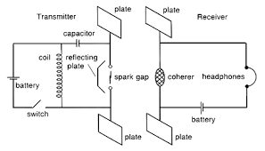
Early Marconi Transmitter/Receiver
Notes:
There were no ‘circuit diagrams’ developed at this time, drawing descriptions looked very mechanical. Spark gap transmitters transmitted literally from DC to light, and initially were not tuned.

Slide 19
Civilian use of Radio Telegraphy
Marconi introduced his ongoing work to the general public at two important London lectures: "Telegraphy without Wires", at the Toynbee Hall on 11 December 1896; and "Signalling through Space without Wires", given to the Royal Institution on 4 June 1897
Through his successful demonstrations, Marconi began to receive international attention, and at last, he carried out a series of tests at La Spezia (1897), in his home country, for the Italian government
A test for Lloyds Insurers between Ballycastle and Rathlin Island, Northern Ireland, was conducted on 6 July 1898, followed by the first transmission across the English channel on 27 March 1899, from Wimereux, France to South Foreland Lighthouse, England

Slide 20
Civilian use of Radio Telegraphy
Marconi set up an experimental base at the Haven Hotel, Sandbanks, Poole Harbour, Dorset, where he erected a 100-foot high mast for his sea transmission experiments involving his yacht Elettra and became friends with the van Raaltes, the owners of Brownsea Island
In December 1898, the British lightship service authorized the establishment of wireless communication between the South Foreland lighthouse at Dover and the East Goodwin lightship, twelve miles distant
This was proved successful on 17 March 1899, when the East Goodwin lightship sent the first SOS message, a signal on behalf of the merchant vessel Elbe which had run aground on Goodwin Sands, which was received by the radio operator of the South Foreland lighthouse, who summoned the aid of the Ramsgate lifeboat

Slide 21
The America's Cup
In the autumn of 1899, the first demonstrations in the United States took place when Marconi sailed to the U.S. at the invitation of the New York Herald newspaper to cover the America's Cup international yacht races off Sandy Hook, New Jersey
The transmission was done aboard the SS Ponce, a passenger ship of the Porto Rico Line
Marconi left for England on 8 November 1899 on the American Line's SS Saint Paul, and he and his assistants installed wireless equipment aboard during the voyage
On 15 November the SS Saint Paul became the first ocean liner to report her imminent return to Great Britain by wireless when Marconi's Royal Needles Hotel radio station contacted her 66 nautical miles off the English coast
Notes:
As wireless telegraphy was novel, Marconi sought the pracrical use of his invention.

Slide 22
Transmission across the Atlantic
At the turn of the 20th century, Marconi began investigating a means to signal across the Atlantic, based upon his sea experience transmissions, in order to compete with the transatlantic telegraph cables
He established a wireless transmitting station at Marconi House, Rosslare Strand, Co. Wexford in 1901 to act as a link between Poldhu in Cornwall, England and Clifden in Co. Galway, Ireland
Upon moving receiving equipment to Signal Hill in St John's, Newfoundland (now part of Canada), he received a weak Morse ‘S’ (three dits) on 12 December 1901, using a 500-foot (150 m) kite-supported antenna with the transmission station being the Marconi Company’s new high-power station at Poldhu, Cornwall
The distance between the two points was about 2,200 miles (3,500 km). It was heralded as a great scientific advance, yet there also was—and continues to be—considerable scepticism about this claim
The exact wavelength used is not known, but it is fairly reliably determined to have been in the neighbourhood of 350 metres (frequency ≈ 850 kHz), but by modern standards is now seen as exceptionally wideband and such a transmission is no longer permitted

Slide 23
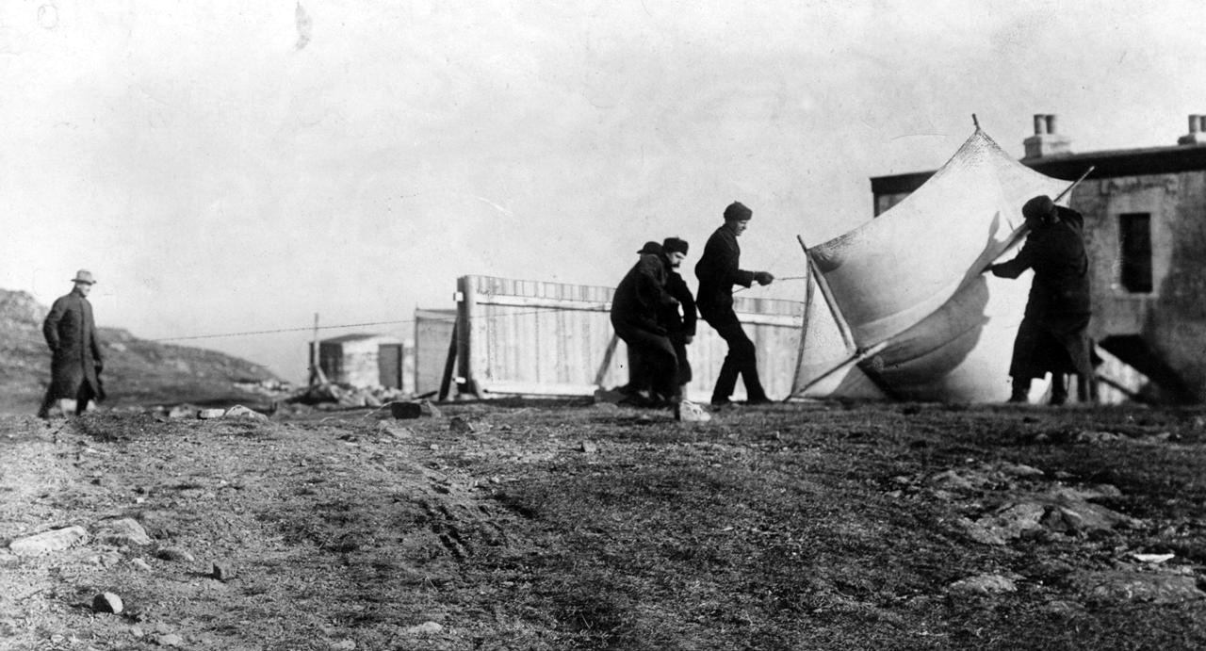
Marconi’s Kite Receiving Antenna
Notes:
Photograph of Guglielmo Marconi and associates raising the receiving antenna by kite at St. John's, Newfoundland in December, 1901 in preparation for his historic first transatlantic radio transmission 11 December 1901 from Poldhu, Cornwall, a distance of 2300 mi (3500 km). Appeared in the article "Marconi's Achievement" in the February, 1902 issue of McClure's Magazine.

Slide 24
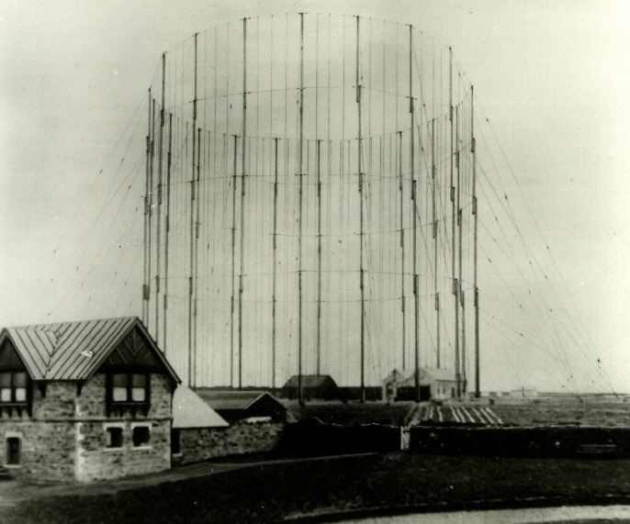
Poldhu Antenna System December 1901

Slide 25
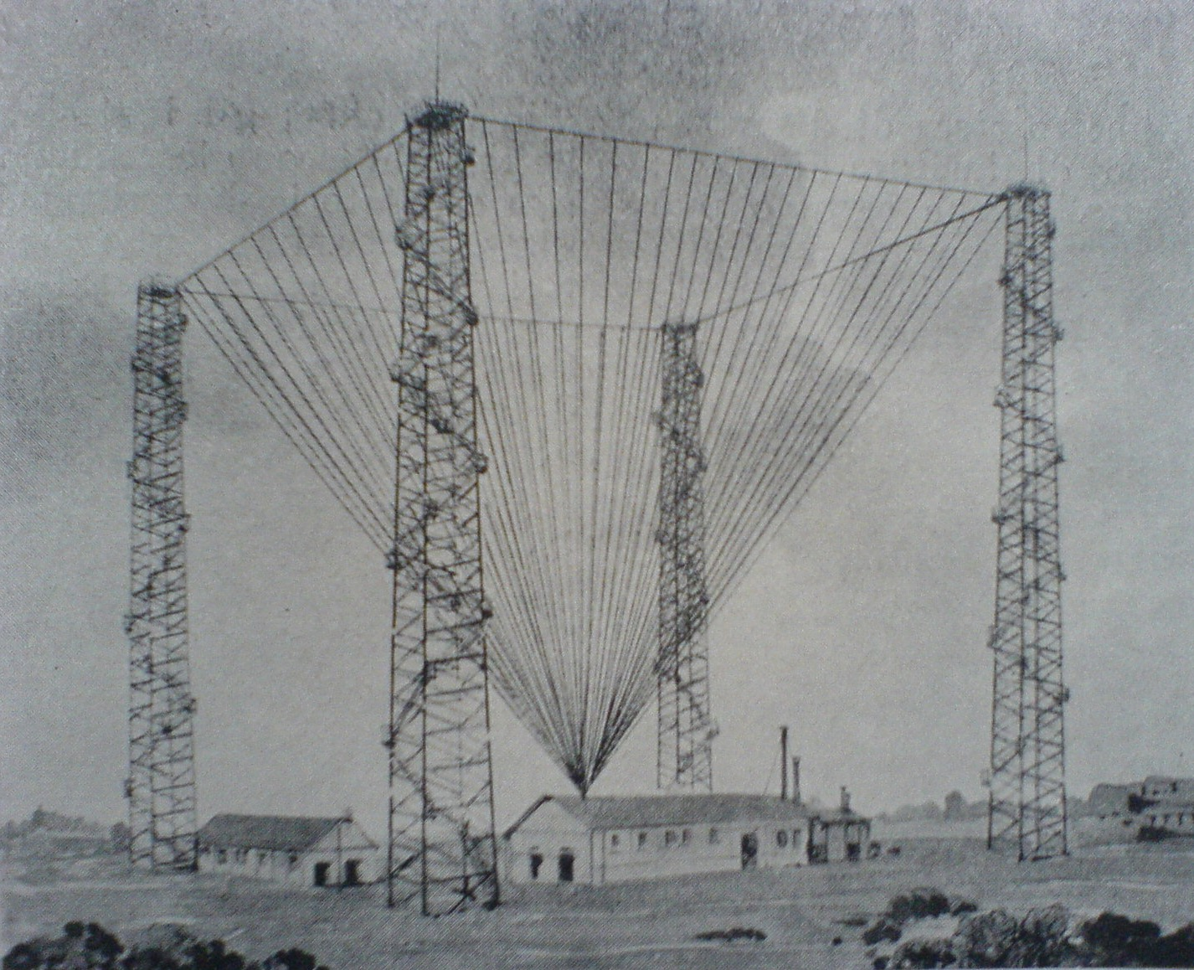
Poldhu Antenna System 1902
Notes:
400 wire system, but not the firsy antenna in site. Top half of a discone antenna in 4 sections

Slide 26
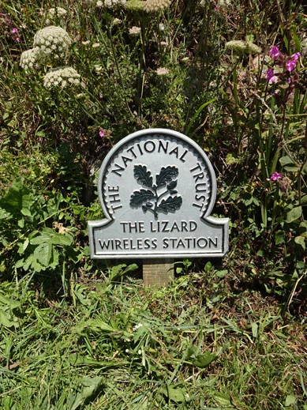
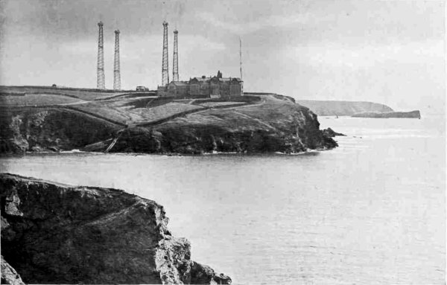
Marconi Poldhu Station Today and Then
Notes:
Poldhu is a small area in south Cornwall, England, UK, situated on the Lizard Peninsula; it comprises Poldhu Point and Poldhu Cove. Poldhu means "black pool" in Cornish. Poldhu lies on the coast of Mount's Bay and is in the northern part of the parish of Mullion; the churchtown is 2 kilometres (1.2 mi) to the south-east. On the north side of Poldhu Cove is the parish of Gunwalloe and the village of Porthleven is a further 7 kilometres (4.3 mi) to the north
The station with four masts

Slide 27
Transmission across the Atlantic - Scepticism
The tests took place at a time of day during which the entire transatlantic path was in daylight and it is now known (although Marconi did not know then) that this was the worst possible choice, and that 1901 was a solar sunspot minimum
At this medium wavelength, long-distance transmission in the daytime is difficult because of heavy absorption of the skywave in the ionosphere
It was not a blind test; Marconi knew in advance to listen for a repetitive signal of three dits, signifying the Morse code letter S, the clicks were reported to have been heard faintly and sporadically
There was no independent confirmation of the reported reception, and the transmissions were difficult to distinguish from atmospheric noise generated from other spark transmissions, e.g. thunderstorms
Notes:
Does long distance radio communication realy exist, or is it our imagination ?

Slide 28
Marconi Response to Criticism
In February 1902, feeling challenged by sceptics, Marconi prepared a better organised and documented test and set out in the SS Philadelphia sailing west from Great Britain, carefully recording signals sent daily from the Poldhu station
The test results produced coherer-tape reception up to 1,550 miles (2,490 km), and audio reception up to 2,100 miles (3,400 km); these maximum distances were achieved at night, daytime distance communications were less than a half
Marconi had not fully confirmed the Newfoundland claims, although he did prove that radio signals could be sent for hundreds of kilometres, despite some scientists' belief that they were limited essentially to line-of-sight distances

Slide 29
Transmission back across the Atlantic
On 17 December 1902, a transmission from the Marconi station in Glace Bay, Nova Scotia, Canada became the world's first radio message to cross the Atlantic from North America, consequently high-powered stations were built on both sides of the Atlantic to communicate with ships at sea, in competition with other inventors
In 1904, he established a commercial service to transmit nightly news summaries to subscribing passenger ships which could incorporate them into their on-board newspapers; a regular transatlantic radio-telegraph service was finally begun on 17 October 1907 between Clifden, Ireland and Glace Bay, but even after this the company struggled for many years to provide reliable communication to others
In 1901, Marconi built a station near South Wellfleet, Massachusetts that sent a greetings message on 18 January 1903 from United States President Theodore Roosevelt to King Edward VII of the United Kingdom, however, consistent transatlantic signalling was difficult to establish

Slide 30
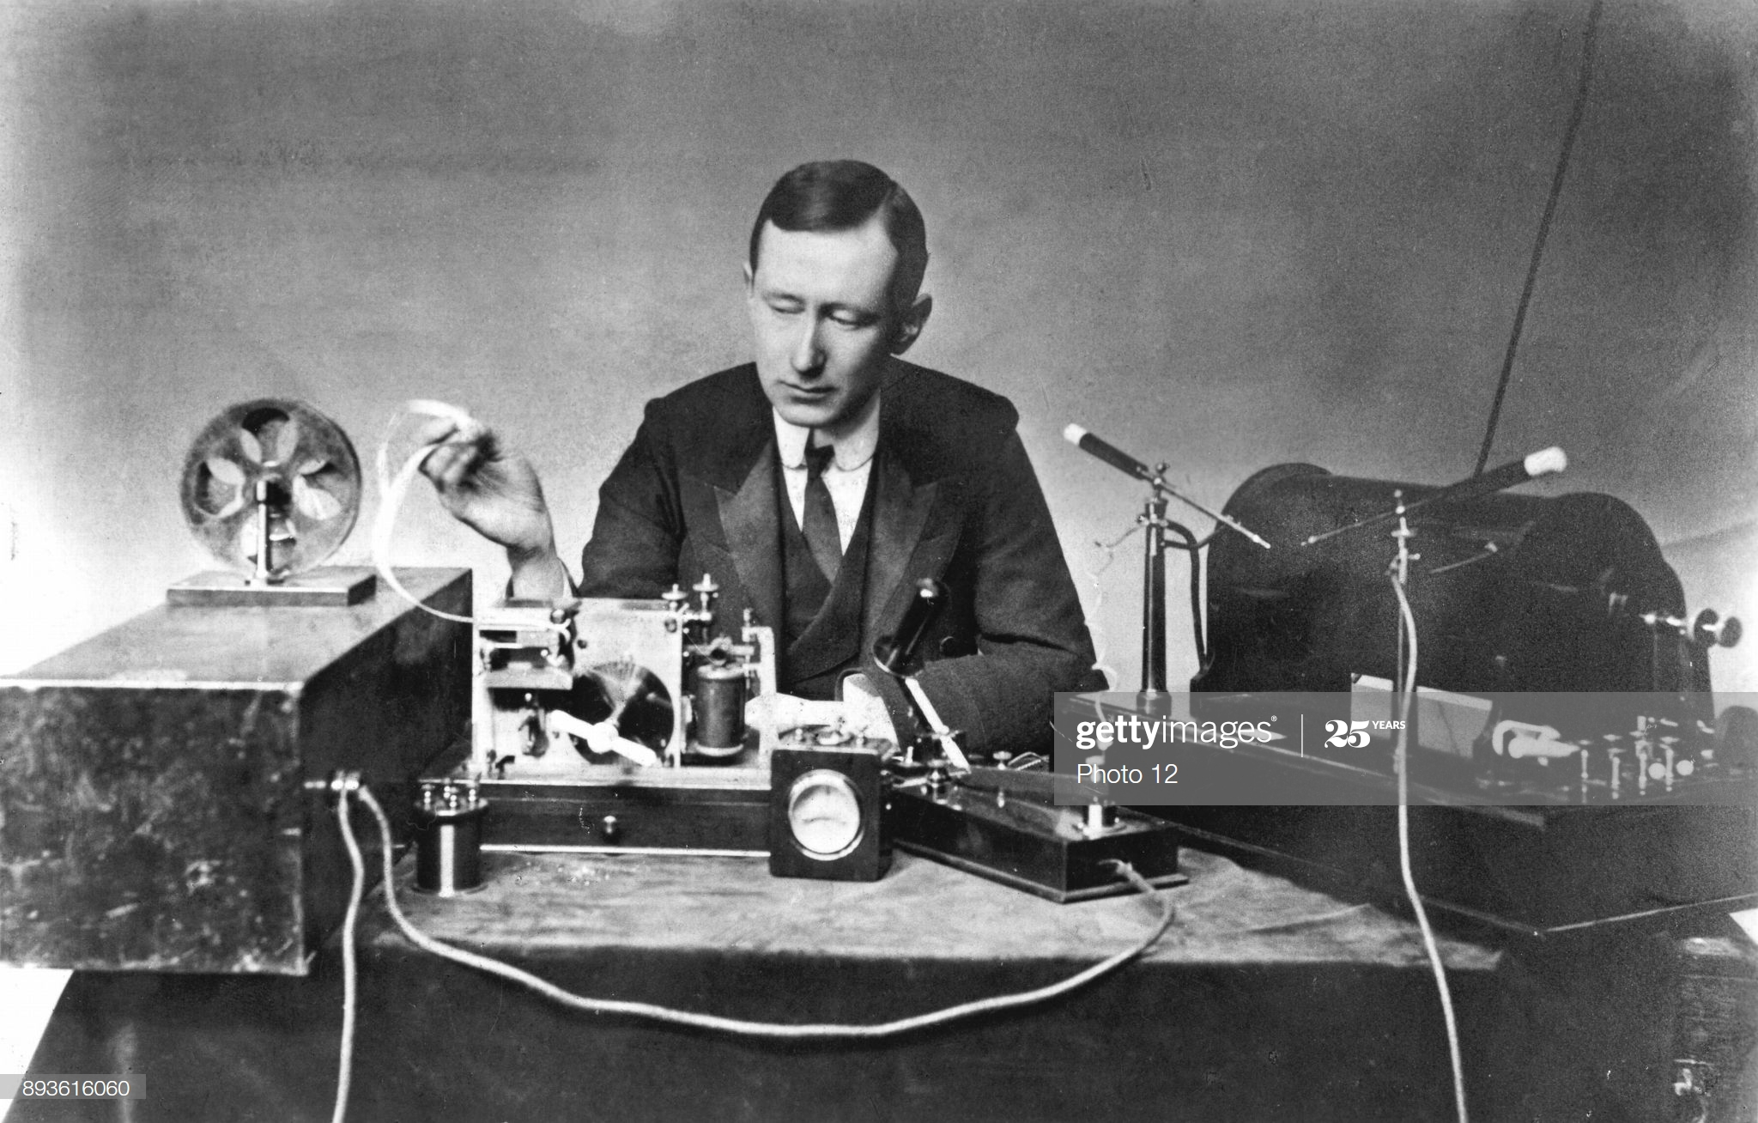
Marconi and his Radio Equipment

Slide 31
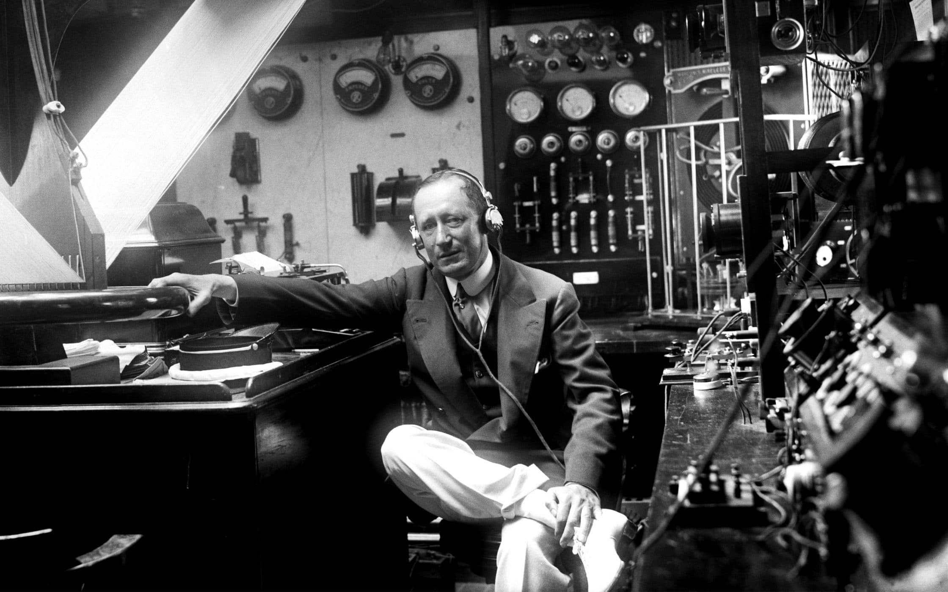
Marconi with more Radio Equipment
Notes:
Note the plethora of meters to monitor thw transmitter functions for optimum usage.

Slide 32
Marconi’s Law
Marconi's law is the relation between length of antennas and maximum signalling distance of radio transmissions
Guglielmo Marconi confirmed Hertz’s analysis of simple vertical sending and receiving antennas of equal height where the maximum working telegraphic distance varied as the square of the height of the antenna; Hertz had died in 1894 at the young age of 36
It has been stated that the rule was tested in experiments made on Salisbury Plain in 1897, and also by experiments made by Italian naval officers on behalf of the Royal Italian Navy in 1900 and 1901
Notes:
Not too many radio amateurs know this.

Slide 33
Maxwell’s Equations
An important consequence of Maxwell's equations is that they demonstrate how fluctuating electric and magnetic fields propagate at a constant speed (c) in a vacuum, known as electromagnetic radiation and occur at radio frequencies
It is doubtful that Marconi utilised the full capabilities of a series of equations formulated by Maxwell (1861/2) to achieve his aim of communications via radio waves, he may have been aware of them but depended more on his engineering heuristic capabilities to investigate optimal communication solutions

Slide 34
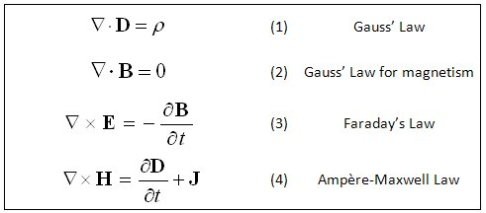
Maxwell’s Electro-Magnetic Equations
Notes:
Maxwell’s equations are very useful for the physicist, but most users of radio communications prefer not to know them

Slide 35
The Titanic Incident
The role played by Marconi Co. wireless in maritime rescues raised public awareness of the value of radio and brought fame to Marconi, particularly the sinking of the RMS Titanic on 15 April 1912 and the RMS Lusitania on 7 May 1915 (sunk by enemy action)
RMS Titanic radio operators Jack Phillips and Harold Bride were not employed by the White Star Line but by the Marconi International Marine Communication Company, similarly the RMS Carpathia (Cunard Line) wireless system was operated by its own Marconi operator; the distress signal from the Titanic consisted of both CQD and SOS signals which was received by Catpethia
When the rescue vessel Carpathia docked in New York, Marconi went aboard with a reporter from The New York Times to talk with Bride, the surviving operator

Slide 36
The Titanic Incident
On 18 June 1912, Marconi gave evidence to the Court of Inquiry into the loss of Titanic regarding the marine telegraphy's functions and the procedures for emergencies at sea; Britain's postmaster-general summed up, referring to the Titanic disaster: "Those who have been saved, have been saved through one man, Mr. Marconi ... and his marvellous invention."
Marconi was offered free passage on Titanic before she sank, but had taken Lusitania three days earlier; as his daughter Degna later explained, he had paperwork to do and preferred the public stenographer aboard that vessel
Notes:
The Titanic incident illuminated the requirement for mobile communications.

Slide 37
The Marconi Scandal and Expansion of Radio Services
The Marconi scandal was a British political scandal that broke in mid-1912; allegations were made that highly placed members of the Liberal government under the Prime Minister H. H. Asquith had profited by improper use of information about the Government's intentions with respect to the Marconi Company
They had known that the government was about to issue a lucrative contract to the British Marconi Company for the Imperial Wireless Chain, and parliamentary members had bought shares in an American subsidiary
The Imperial Wireless Chain was a strategic international communications network of powerful long range radiotelegraphy stations, created for the British government to link the countries of the British Empire by exchanging commercial and diplomatic text message traffic transmitted at high speed by Morse code using paper tape machines
The BBC World Service began in 1932 as the BBC Empire Service using valves and amplitude modulation equipment on shortwave and aimed principally at English-speakers across the British Empire; in his first Christmas Message (1932), King George V characterised the service as intended for "men and women, so cut off by the snow, the desert, or the sea, that only voices out of the air can reach them"
Notes:
Scandals are rife when there are inventions.

Slide 38
Revision
Guglielmo Marconi Wireless Telegraphy 14:21 https://www.youtube.com/watch?v=g57z0qFdPdQ

Slide 39
The Marconi Company and WWI
It was obvious from the outbreak of World War I in 1914 that wireless had become a technology of great strategic importance and the British government immediately took control of parts of the Marconi company, such as its latest transatlantic stations in Wales and its factory in Chelmsford, and the company established an ambitious training programme for military wireless operators
While government restrictions meant that public developments were suspended, the demands of war – for land, sea and airborne services – meant that other technical developments were accelerated; radio was replacing the homing pigeon
Wartime priorities emphasised the potential for counter-offensive inherent in wireless communication – signals could be intercepted, for example, and direction-finding techniques could locate the positions of enemy transmitters
Once it was possible to instal trench wireless sets, enemy troop positions could be communicated, as well as Zeppelins and other hostile aircraft; it was detection of wireless traffic that alerted the Royal Navy to the movements of the German fleet and precipitated the Battle of Jutland in May 1916
Notes:
WWI accelerated the development of wireless communications.

Slide 40
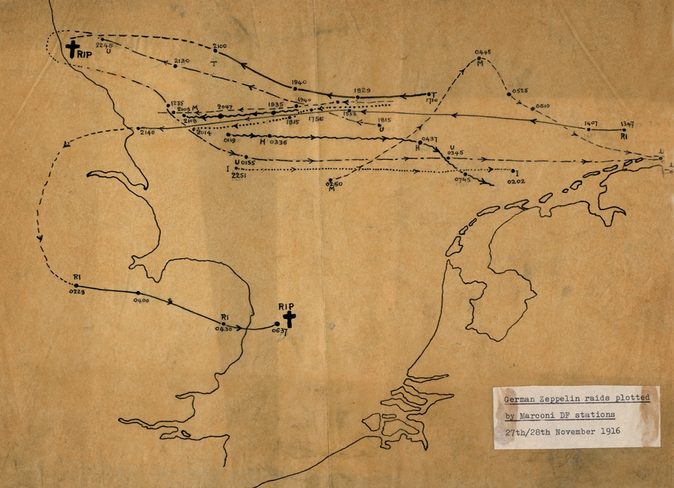
Map of Zeppelin routes tracked by Marconi Direction Finding
Notes:
Map of Zeppelin routes tracked by Marconi Direction Finding equipment on 27–28 November 1916. Zeppelins (German airships) were used for reconnaissance and for bombing raids over the east coast of Britain. This map shows that two of the airships were shot down at the places marked.

Slide 41
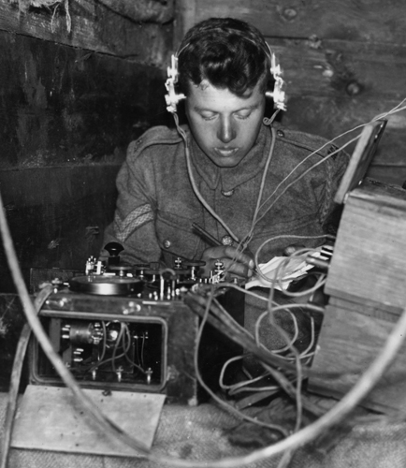
Interior of Royal Engineers, British Army forward wireless station
Notes:
Interior of Royal Engineers, British Army forward wireless station at Moyenneville, the Somme in 1917

Slide 42
Continuing Radio Development
Marconi companies gained a reputation for being technically conservative, in particular by continuing to use inefficient spark-transmitter technology, which could be used only for radio-telegraph operations, long after it was apparent that the future of radio communication lay with continuous-wave transmissions which were more efficient and could be used for audio transmissions
Belatedly, the company did begin significant work with continuous-wave equipment beginning in 1915, after the introduction of the oscillating vacuum valve
On the 15 June 1920 the opera soprano Dame Nellie Melba gave a pioneering amplitude modulation broadcast from Marconi’s New street Works factory in Chelmsford; when shown the 450ft twin masts and told that she would be heard all over the world, it is said that she replied ‘ Young man if you think that I am going to climb up there, you are very much mistaken’, her pioneering radio transmissions actually reached New York

Slide 43
The Start of Audio Broadcast
Celebrating Centenary of British Broadcasting 2020-2022 22.27 https://www.youtube.com/watch?v=-Xq_F2JTKGU

Slide 44
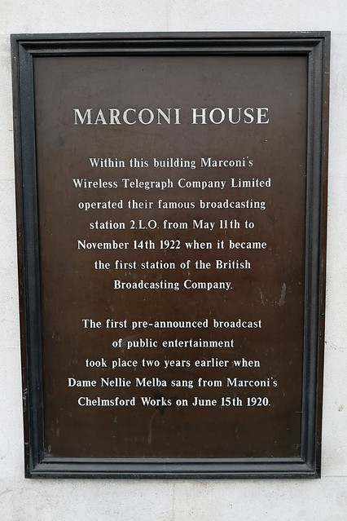
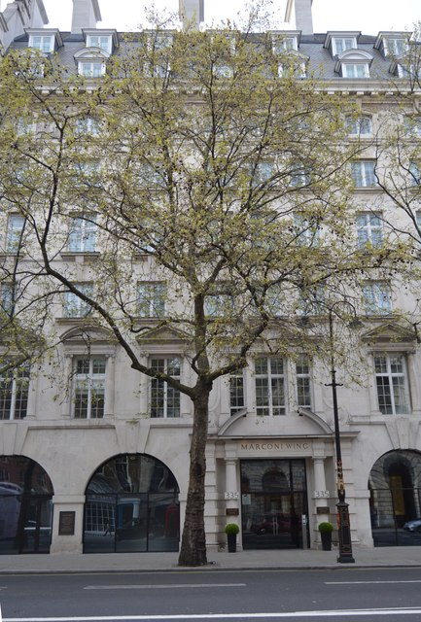
Marconi House, 335 Strand, London
Notes:
Marconi House is a Grade II listed building at 335 Strand (at its junction with Aldwych) in London

Slide 45
Continuing Radio Development
A Marconi radio station with the call sign 2MT transmitted from an ex-army hut in Writtle, near Chelmsford and gave the first regular radio broadcasts starting on 14 February 1922 using amplitude modulation on 428kHz; this was repeated on Tuesdays 20:00 to 20:30 giving general announcements
2MT was gradually superseded by another station (2LO, 11 May 1922) which transmitted 1 hour per day from Marconi House, The Strand, London; and incorporated later that year into the British Broadcasting Company, emerging as the British Broadcasting Corporation in 1927 transmitting regional programmes
Also in 1922, regular entertainment broadcasts commenced from the Marconi Research Centre at Great Baddow
In that same year, Marconi had spoken in a private gathering of aviation and interplanetary radio communications
Notes:
A civilian use for continuous wireless communications has been found.

Slide 46
Crystal Radio Receiver
Amplitude modulation transmitters used expensive vacuum valves, but nothing inexpensive was available of similar technology for the public to receive the emerging and intriguing radio programmes
The requirement was fulfilled by the crystal radio receiver, also called a crystal set, is a simple radio receiver and uses only the power of the received radio signal to produce sound
The rectifying property of a contact between the mineral galena and a metal was discovered in 1874 by Karl Ferdinand Braun and was first used as a detector of radio waves in 1894 by Jagadish Chandra Bose and as a demodulator for radio communication reception in 1902 by G. W. Pickard
Crystal radio receivers had their limitations in signal sensitivity and selectivity with weak audio, now replaced by superheterodyne frequency selection systems and software defined radios
Notes:
Allied prisoners of war during WWII made crystal sets by using dissimilar metals to detect signals and stolen headphones.

Slide 47
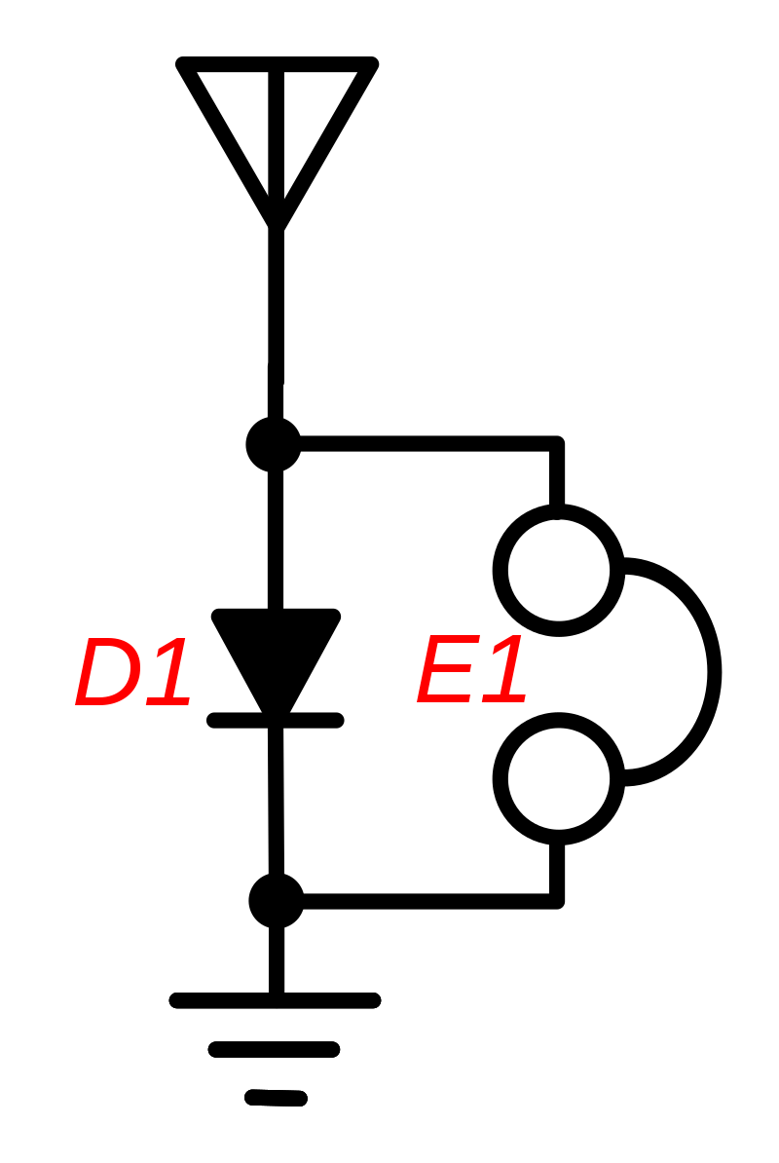
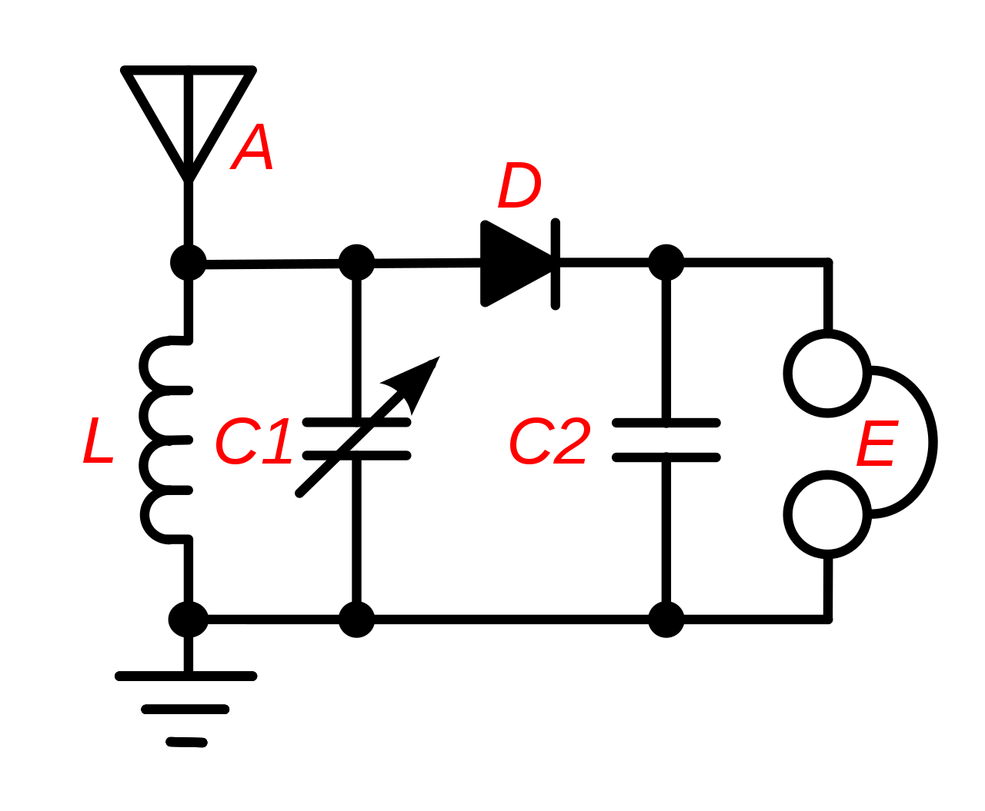
Crystal Radio Receiver
Untuned
Tuned
Notes:
RHS with tuning capacitor C1.

Slide 48
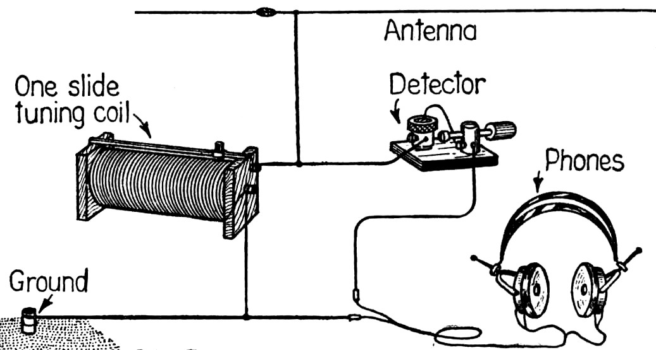
Crystal Radio Receiver
Notes:
Pictorial diagram from 1922 showing the circuit of a crystal radio. This common circuit did not use a tuning capacitor, but used the capacitance of the antenna to form the tuned circuit with the coil. The detector was a cat whisker detector, consisting of a piece of galena with a thin wire in contact with it on a part of the crystal, making a diode contact. A friend demonstrated to me a crystal receiver (made by his father) with a sliding tuning coil which convinced me of becoming an electronics engineer

Slide 49
Vatican Radio
Set up in 1931 by Guglielmo Marconi, the first signal that was sent out from Vatican Radio on Feb. 12, 1931, was however in Morse code with the callsign HVJ on two shortwave frequencies using 10 kilowatts (kW) of power, a year before the establishment of the BBC World Service
This was followed by Marconi speaking in Italian: ‘I have the highest honour of announcing that in only a matter of seconds the Supreme Pontiff, Pope Pius XI, will inaugurate the Radio Station of Vatican City State. The electric radio waves will carry to all the world his words of peace and blessing.’
The inaugural speech was in Latin, starting with "Omni creaturae“; since its inception, Vatican Radio has been maintained by the Jesuit Order and preserved its independence during the rise of Fascist Italy and Nazi Germany
Following the outbreak of World War II Vatican Radio broadcast the news that Poles and Jews were being rounded up and forced into ghettos

Slide 50
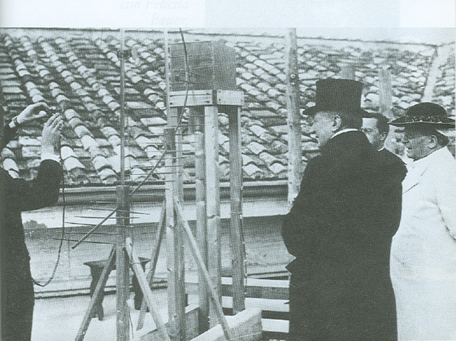
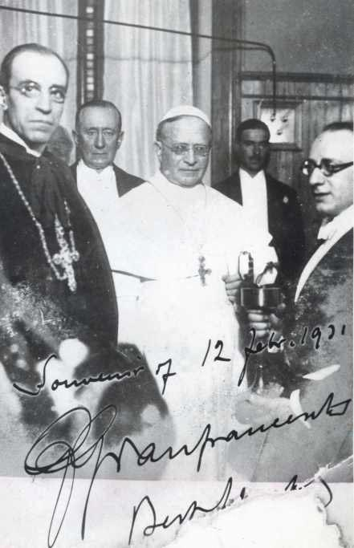
Inauguration of Vatican Radio
Notes:
Pope Pius XI,
his successor Pacelli with Marconi at starting of Vatican Radio 1931
Guglielmo Marconi e papa Pio XI con il trasmettitore a onde ultracorte in Vaticano a Castel Gandolfo.

Slide 51
Louis Varney – G5RV
Louis Varney (1911 -2000) was a ‘Technical Representative’ for the Marconi company, and had shaken the hand of Guglielmo Marconi, and was a prolific radio amateur who lived in Burgess Hill until his death
He is the inventor of one of the most commonly used amateur radio antennas, the G5RV using wire and ladder line, and held 60 amateur radio call signs (including G5RV) and was the Life President of the Mid Sussex Amateur Radio Society for 23 years
Louis Varney came between a hair’s breadth of inadvertently purchasing the original Marconi kite used in Newfoundland, that had been stored at the company’s premises in Chelmsford
G5RV was in Lydd operating a ‘Y’ station during WWII; the Marconi Company helped the military and government services to monitor enemy stations ashore and afloat and in localising and providing code that could be decrypted by Bletchley Park
More details are given on the websites http://www.msars.org.uk/ and Chelmsford Amateur Radio Society (CARS), Essex, UK, G0MWT / GX0MWT, many thanks to G0WGP, and M5AKA

Slide 52
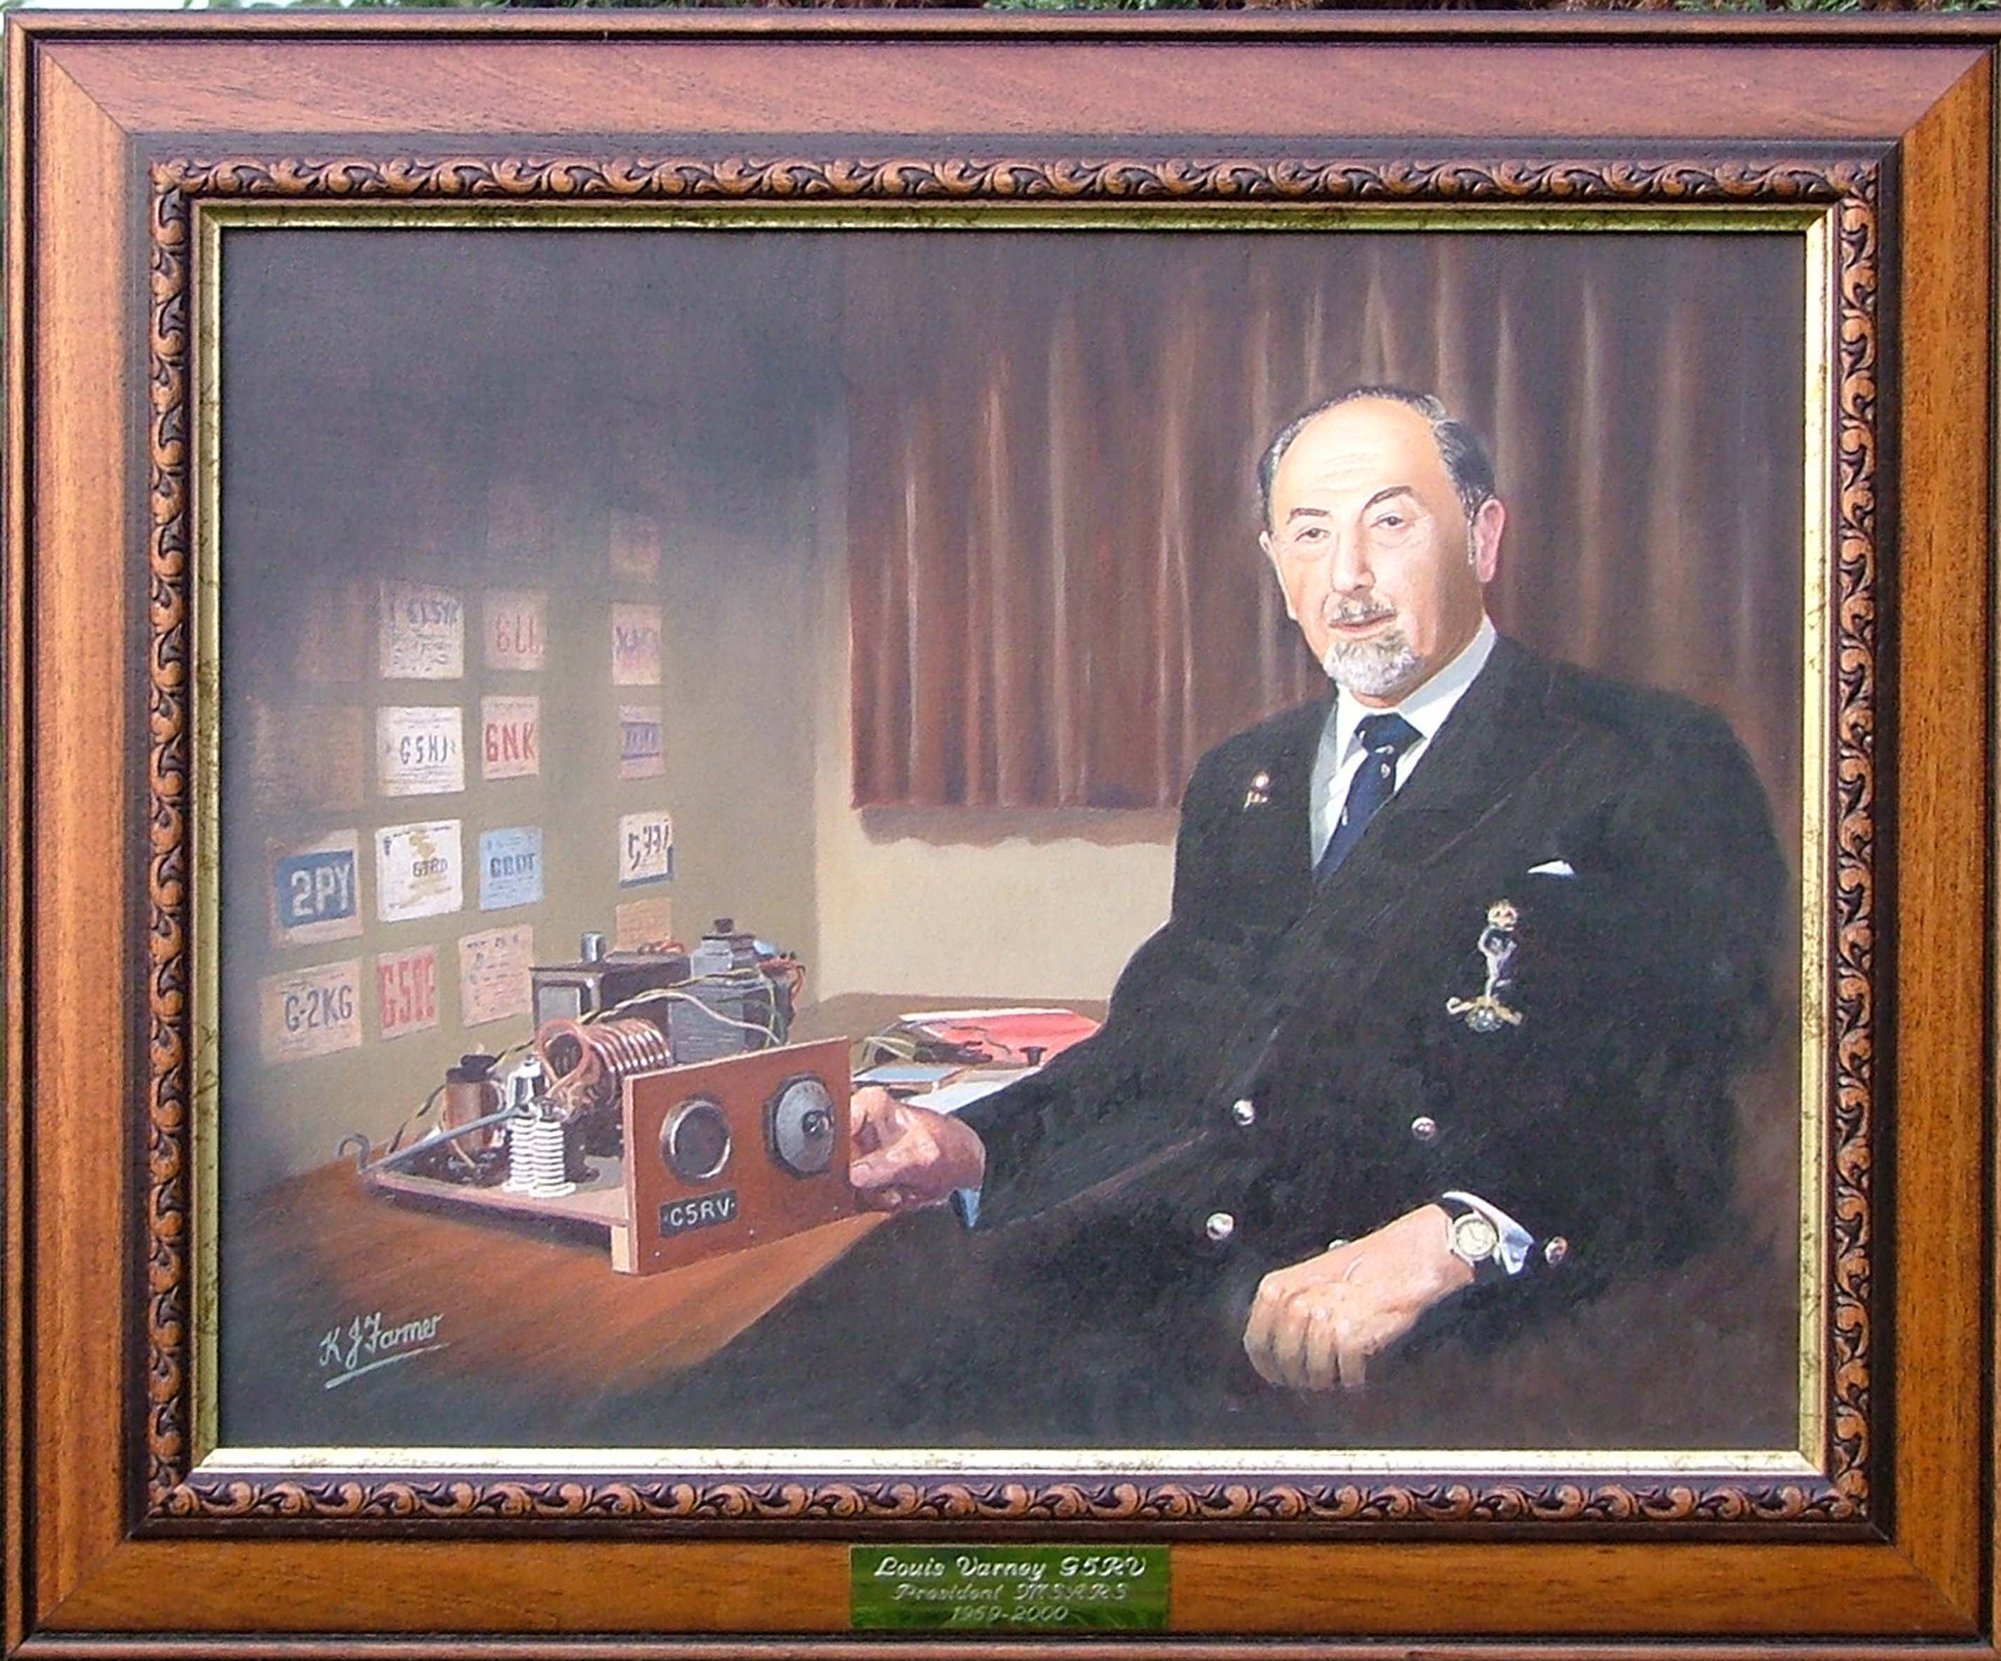
Louis Varney – G5RV
Notes:
Painting of Louis Varney in the Mid Sussex Amateur Radio shack

Slide 53
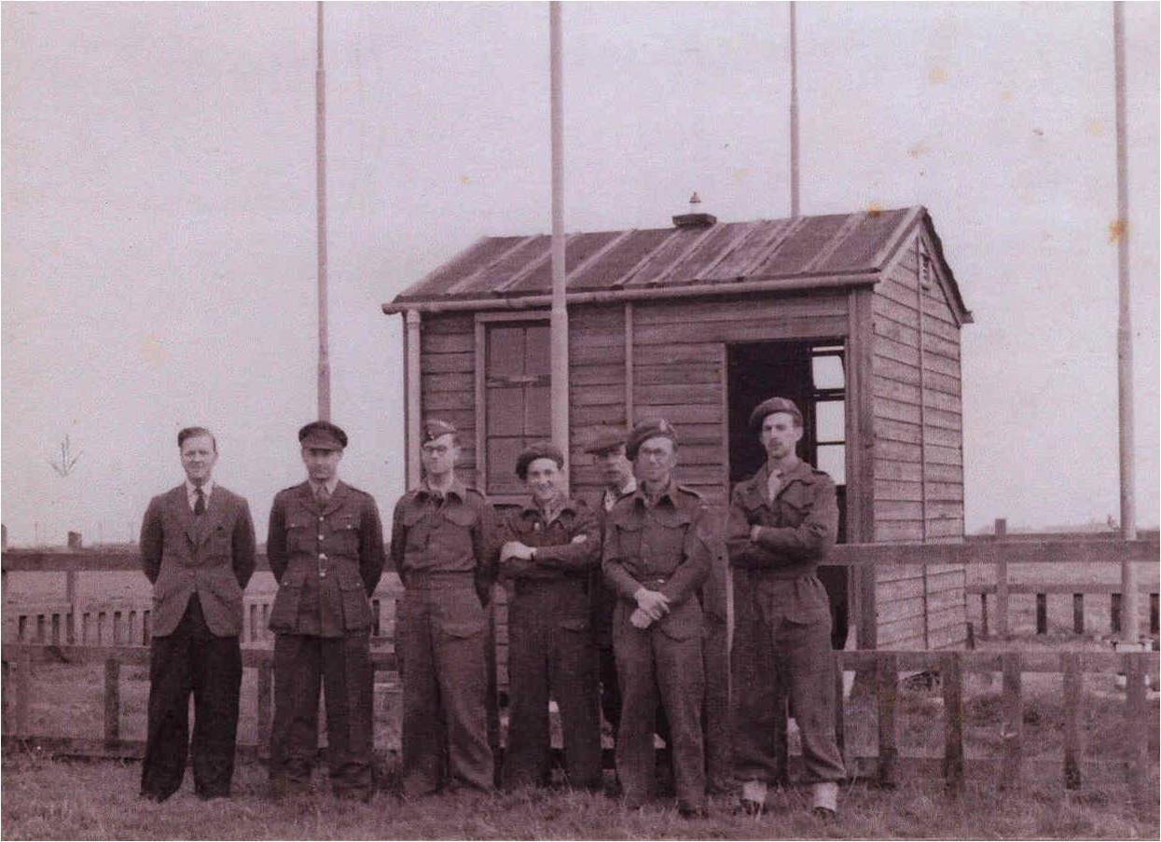
Louis Varney, ‘Y’ Station Operator (Lydd, 2nd left)
Notes:
G5RV second from left, in uniform

Slide 54
Marconi’s Married Life
Marconi married Beatrice O'Brien in 1905 and spent their honeymoon on Brownsea Island where he had conducted many radiotelegraphic experiments, owned by their friends the van Raalte family, and had three daughters and a son who became the 2nd Marchese Marconi
In 1913 the Marconis returned to Italy and became part of Rome society but divorced in 1927 so he could marry the much younger Maria Cristina Bezzi-Scali To marry his second wife he had to be confirmed in the Catholic faith and became a devout member; he had been baptised Catholic but brought up as a member of the Anglican Church; he set-up Vatican Radio in 1933
They had one daughter, Maria Elettra Elena Anna (born 1930), for unknown reasons Marconi left his entire fortune to his second wife and their only child, and nothing to the children of his first marriage; Elettra was also the name of his yacht which he used in some of his early sea experiments
His daughter became known as Princess Elettra, as her father had been elevated to marquess in 1929 by King Victor Emmanuel III

Slide 55
Marconi’s Personal Life
In 1914, Marconi was made a Senator in the Senate of the Kingdom of Italy and appointed Honorary Knight Grand Cross of the Royal Victorian Order in the UK; as Italy joined the Allies during World War I, Marconi was placed in charge of the Italian military's radio service and attained the rank of lieutenant in the Royal Italian Army and of commander in the Regia Marina
While helping to develop microwave technology, Marconi suffered nine heart attacks in the span of 3 years preceding his death and died in Rome on 20 July 1937 at age 63, following the ninth, fatal, heart attack, and Italy held a state funeral for him
As a tribute, shops on the street where he lived were "Closed for national mourning“, and at 6 pm the next day, the time designated for the funeral, all BBC transmitters and wireless Post Office transmitters in the British Isles observed two minutes of silence in his honour; the British Post Office also sent a message requesting that all broadcasting ships honour Marconi with two minutes of broadcasting silence as well, his remains are housed in the Villa Griffone at Sasso Marconi, Emilia-Romagna, which assumed that name in his honour in 1938
In 1943, Marconi's elegant sailing yacht and floating laboratory, the Elettra, was commandeered and re-fitted as a warship by the German Navy, but was sunk by the RAF on 22 January 1944; efforts were made after the war to retrieve the historic wreckage, but was abandoned, leading to parts being distributed to Italian museums; Guglielmo Marconi e l'Elettra 2:26 https://www.youtube.com/watch?v=1Uc79Yq8-qg worth watching even in Italian

Slide 56
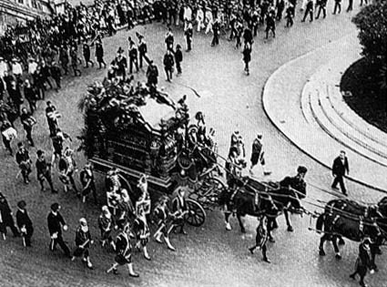
The Italian State Funeral of Marconi
Funeral. Last Rites To Marconi
https://www.youtube.com/watch?v=OFfAQe6HPxI
Notes:
He died on 20 July 1937.

Slide 57
Marconi’s Political Life
Marconi joined the Italian Fascist party in 1923, in 1929 he was made a marquess and in 1930, Italian dictator Benito Mussolini appointed him President of the Royal Academy of Italy, which made Marconi a member of the Fascist Grand Council
Marconi was an active Italian Fascist and an apologist for their ideology and actions such as the attack by Italian forces in Ethiopia; he once stated: «I reclaim the honour of being the first fascist in the field of radiotelegraphy, the first who acknowledged the utility of joining the electric rays in a bundle, as Mussolini was the first in the political field who acknowledged the necessity of merging all the healthy energies of the country into a bundle, for the greater greatness of Italy»
Notes:
Marconi was in a politically sensitive position,

Slide 58
Marconi - British or Italian ?
From English Wikipedia: Alfonso [brother of Guglielmo], not Guglielmo, was a pupil at Bedford School: 'It is not generally known that the Marconi family at one time lived in Bedford, in the house on Bromham Road on the western corner of Ashburnham Road, and that the elder brother of the renowned Marchese Marconi attended this School for four years.' The Ousel, June 1936, p. 78. From Alfonso's obituary
There is also a Blue Plaque commemorating his Bedford accommodation as being in Harpur Street, Bedford; many Italians settled around Bedford after the Second World War
There is no reference to Bedford in either the French or Italian versions of Marconi’s life in Wikipedia

Slide 59
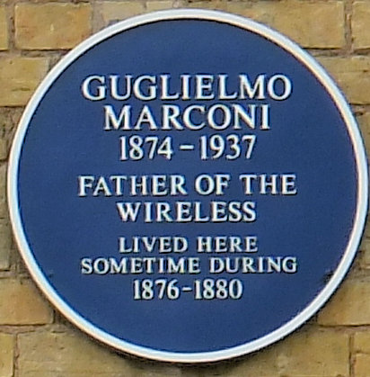
Marconi Blue Plaque
Notes:
This blue plaque, to Guglielmo Marconi the "father of the wireless", is attached to a building on the west side of Harpur Street, just north of Dame Alice Street, in Bedford.

Slide 60
Tributes to Marconi
Princess Elettra Marconi on the Cape (Newfoundand) 1:38 https://www.youtube.com/watch?v=rtCUHn-u3d8
Vatican Radio Museum Shows Evolution Of Technology 1:49 https://www.youtube.com/watch?v=LfcViDZ38Kg
Notes:
I think that Princess Elettra enjoyed her QSO.
I visited Tge Vatican in the 1991 before ethe radio museum was open. But I did sneak down a back stairwell into the gardens to view the HF yagi antenna, before I was told to remove myself.

Slide 61

Marconi $5.00 Shares Across the World
Notes:
Marconi US share certificate

Slide 62
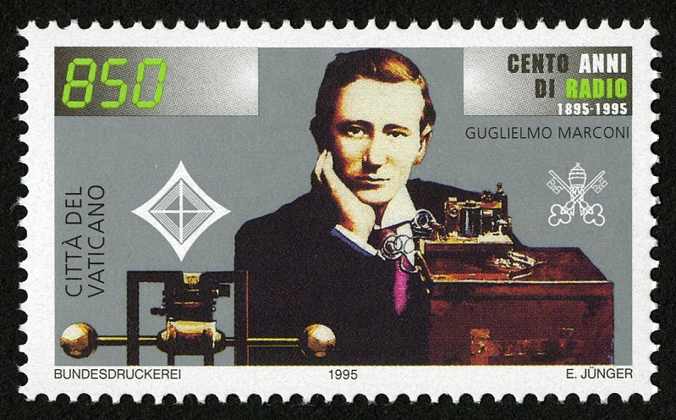
Italian 850 Lira Stamp (1995)

Slide 63
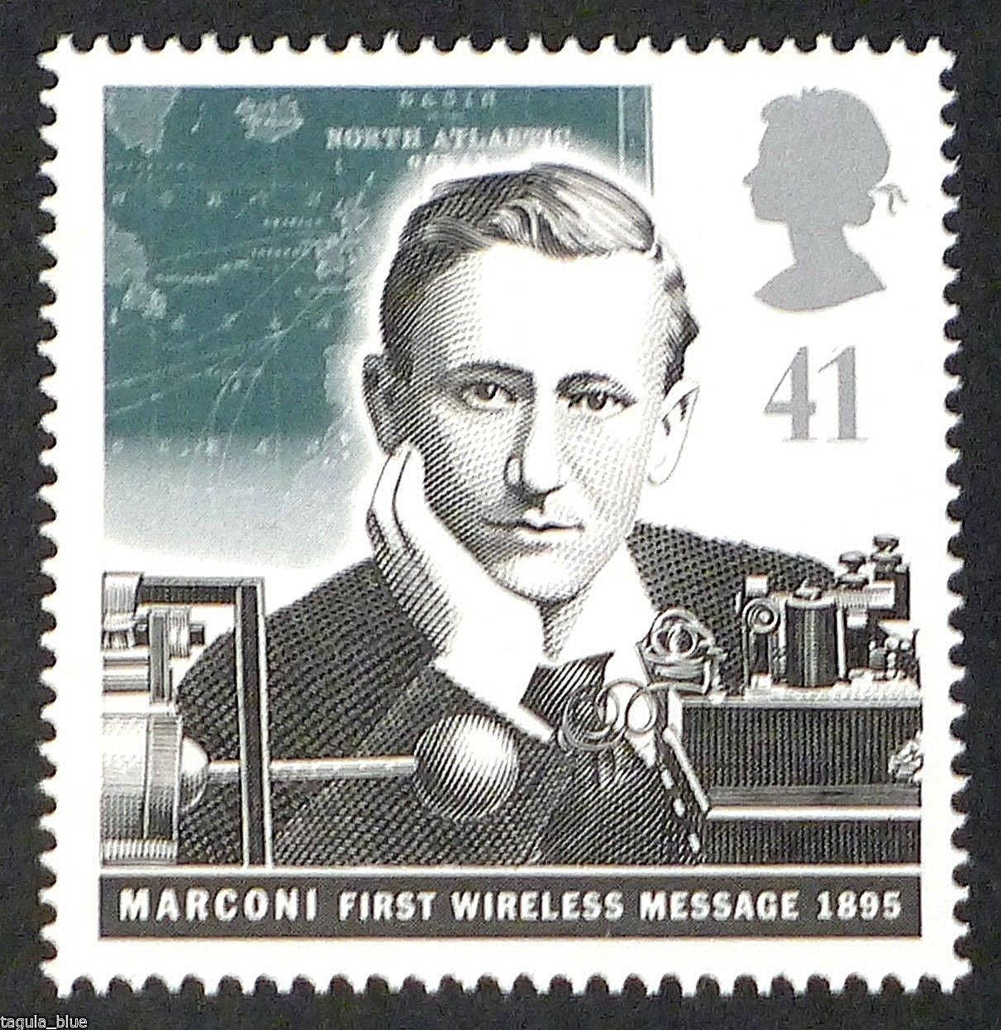
British 41p Stamp (1995)

Slide 64
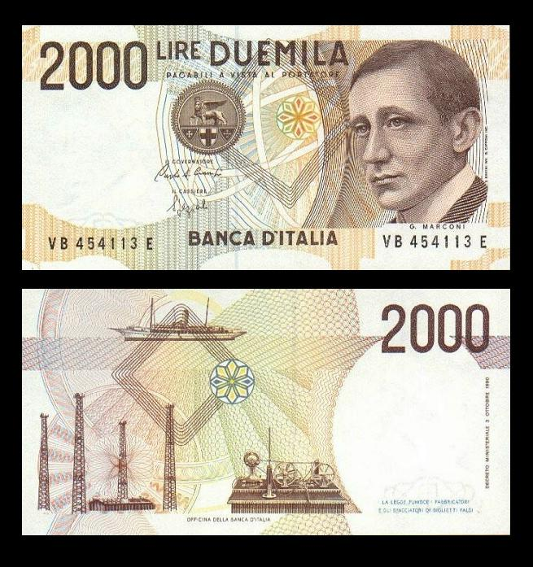
2000 Lira Bank Note
Notes:
With a sketch of the Elettra. Elettra is a common Italian forename and is also the name of an Italian technical centre, though it is not known if this centre has any relationship with Marconi.

Slide 65
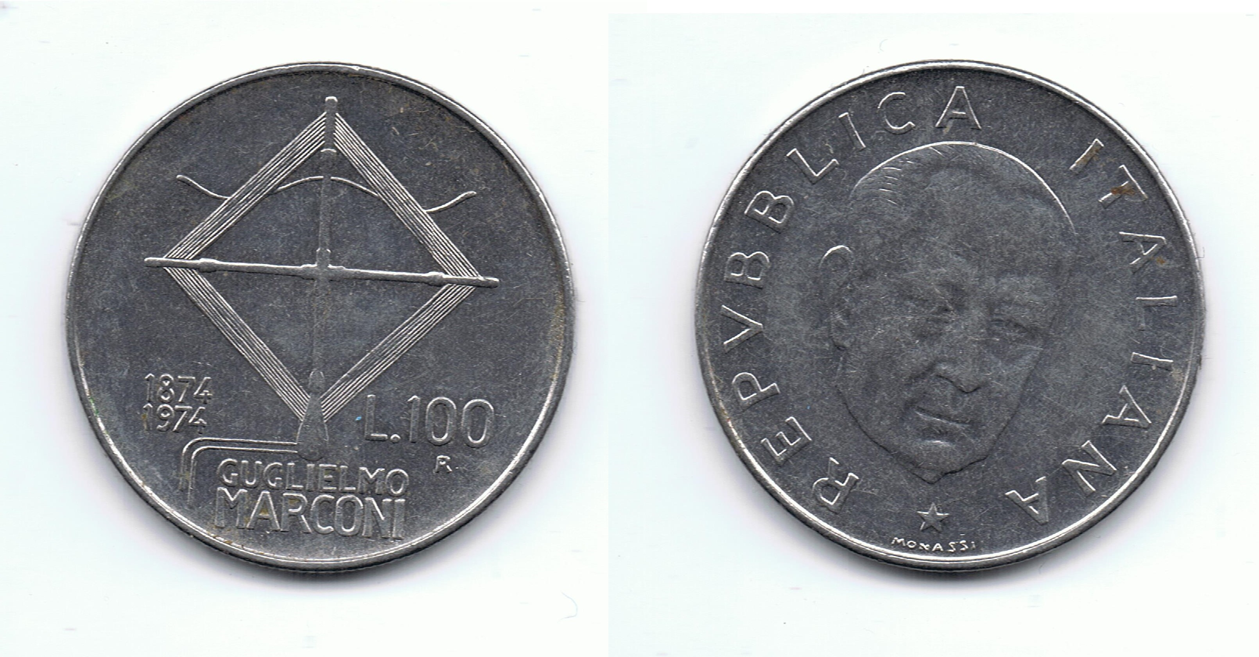
100 Lira Coin (1974)
Notes:
Depicts what is believed to be an early magnetic loop antenna

Slide 66
Selection of Places and Organisations named after Marconi
Solar System: One asteroid and a moon crater
UK: Marconi House, Strand, London
Italy: an airport, a university technical department, a university and a bridge
Sweden: a bridge
Australia: soccer and social club
Canada: Marconi’s ‘Wireless Telegraph Company of Canada’ still exists on several sites but name changes have occurred, the Marconi National Historic Sites of Canada was created by Parks Canada
USA: At least 6 states have Marconi memorials which include a conference centre, school, park, beach and several radio telegraphy stations

Slide 67
British Patents
British patent No. 12,039 (1897) "Improvements in Transmitting Electrical impulses and Signals, and in Apparatus therefor". Date of Application 2 June 1896; Complete Specification Left, 2 March 1897; Accepted, 2 July 1897 (later claimed by Oliver Lodge to contain his own ideas which he failed to patent).
British patent No. 7,777 (1900) "Improvements in Apparatus for Wireless Telegraphy". Date of Application 26 April 1900; Complete Specification Left, 25 February 1901; Accepted, 13 April 1901 and British patent No. 10245 (1902)
British patent No. 5113 (1904) "Improvements in Transmitters suitable for Wireless Telegraphy". Date of Application 1 March 1904; Complete Specification Left, 30 November 1904; Accepted, 19 January August 1905 and British patent No. 21640 (1904) "Improvements in Apparatus for Wireless Telegraphy". Date of Application 8 October 1904; Complete Specification Left, 6 July 1905; Accepted, 10 August 1905.
British patent No. 14788 (1904) "Improvements in or relating to Wireless Telegraphy". Date of Application 18 July 1905; Complete Specification Left, 23 January 1906; Accepted, 10 May 1906
Notes:
Extract from one of the patents286 APPENDIX C. Fig. 5. If a wire connected at some point to the circuit is passed out through a hole in the box to a distance of 20 to 50 cms., the influence of the Wilmshurst machine makes itself felt. On tapping the lid to re- store resistance, the galvanometer needle remains deflected so long as the sparks continue to pass. If, however, the wires are pushed in so that they only project a few millimetres, the sparks still passing, a few taps suffice to bring back the needle to zero. On touching the end of the wire with the fingers or a piece of metal, conductivity is immediately restored. The movements of the galvanometer needle were rendered visible in these experiments by looking through a piece of wide -mesh wire -gauze with a telescope.

Slide 68
US Patents
In the name of Guglielmo Marconi, 32 US patents were raised between 1897 and 1934, but in 1943, the Supreme Court of the United States handed down a decision on Marconi's radio patents restoring some of the prior patents of Oliver Lodge, John Stone, and Nikola Tesla
The decision was not about Marconi's original radio patents and the court declared that their decision had no bearing on Marconi's claim as the first to achieve radio transmission, just that since the Marconi's claim to certain patents were questionable
There are claims the high court was trying to nullify a World War I claim against the United States government by the Marconi Company via simply restoring the non-Marconi prior patents
It must also be borne in mind that Marconi had been a member of the Italian fascist party, though he had died in 1937
Tesla vs. Marconi: Who Invented Radio 2:02 https://www.youtube.com/watch?v=y_35zN07Qd4

Slide 69
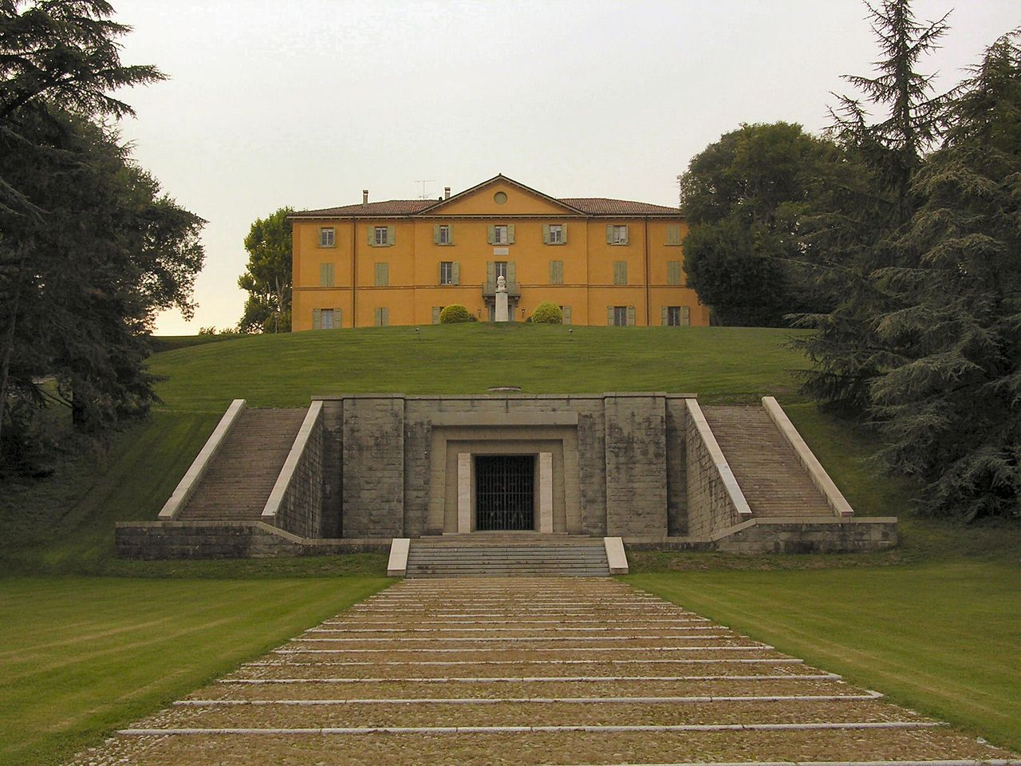
The Tomb of Gugliemo Marconi
Notes:
Villa Marconi and his tomb

Slide 70
QRT
SILENT KEY

